Slide 1
Difference between fuels
Fuel type | Avg. Distance (km) | Avg. Speed (km/h) | Avg. Fuel consumption (l/100km) | Avg. Fuel Spent (l) | Price per liter | Avg. cost (€)
E10 | 21.096250 | 43.506250 | 4.931250 | 1.008933 | 1.82 | 1.836257
SP98 | 18.639912 | 40.820175 | 4.899123 | 0.883618 | 1.95 | 1.723056
SP98 is more expensive by liter, but tends to offer better performance at lower speeds

Slide 2
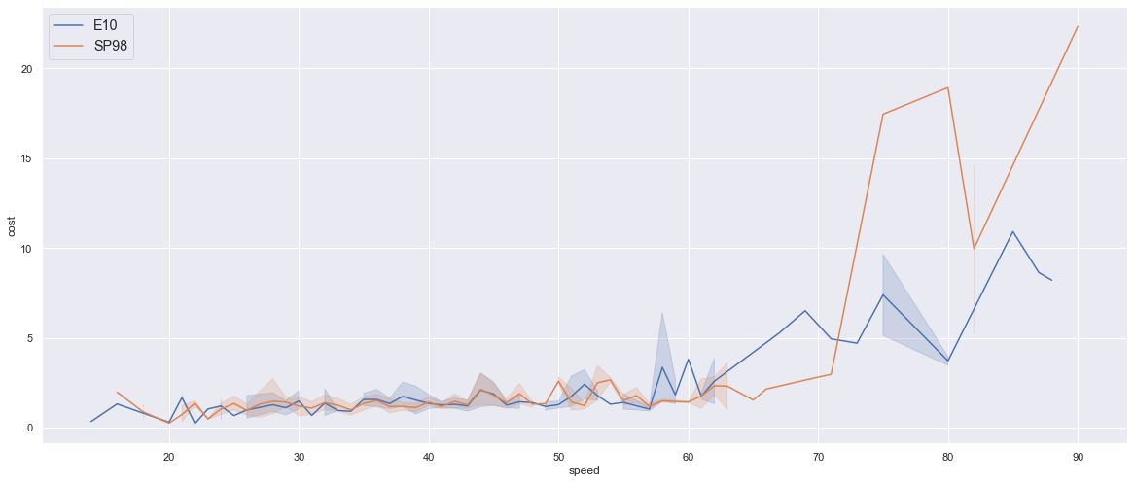
Cost versus speed

